Slide 1
Manipulating and Traversing HTML DOM Using jQuery

Slide 2
Objectives
In this session, you will learn to:
  Traverse the DOM
  Implement jQuery events

Slide 3
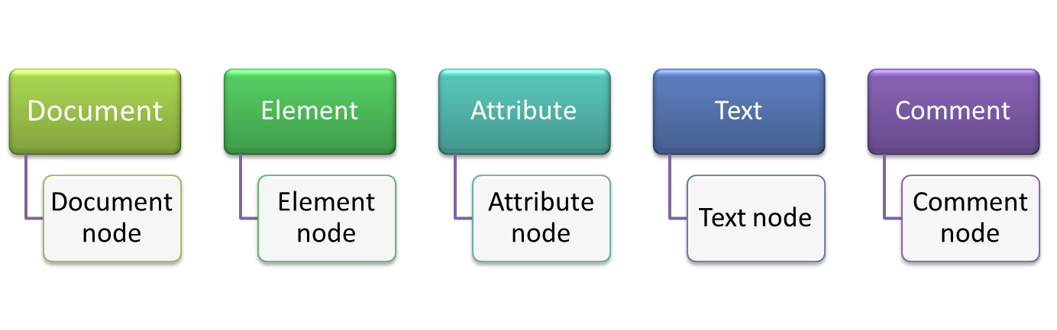
Traversing the DOM
jQuery methods enable you to easily traverse the HTML Document Object Model (DOM) and select the different elements to manipulate them.
DOM represents the logical structure of HTML documents.
It describes the ways through which a document is accessed and manipulated.
Using the HTML DOM, you can navigate through the structure of HTML documents and add, modify, or delete elements and content.
In the HTML DOM, everything is treated as a node. For example:

Slide 4
Traversing the DOM (Contd.)
Consider the following code snippet of an HTML document:
<html>
<head>
<title>Text</title>
</head>
<body>
<TABLE>
<TR>
<TD>Jensen Ackles</TD>
<TD>Jared Padalecki</TD>
</TR>
<TR>
<TD>Supernatural</TD>
<TD>Supernatural</TD>
</TR>
</TABLE>
</body>
</html>

Slide 5
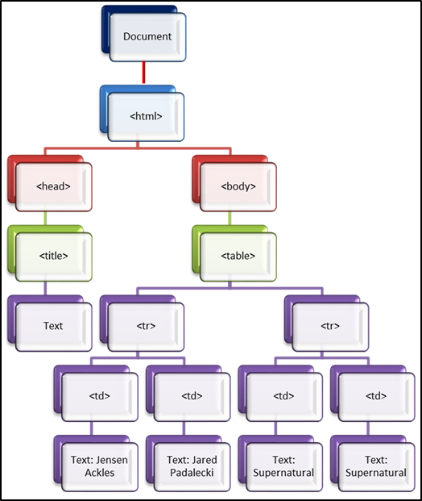
Traversing the DOM (Contd.)
The following figure depicts the DOM representation of the HTML Document.

Slide 6
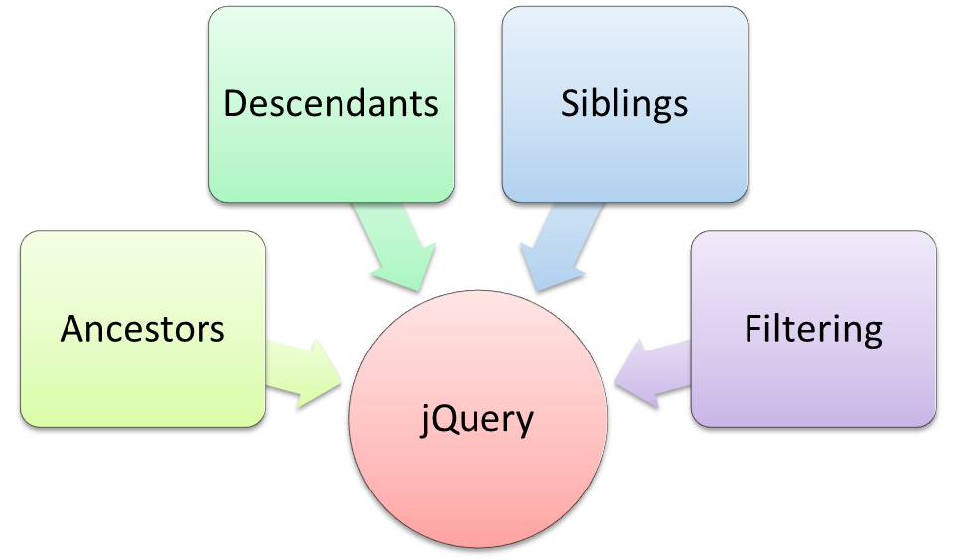
Traversing the DOM (Contd.)
jQuery provides various methods that enable you to traverse DOM.
These methods are divided into the following categories.
Use the animation, RWD_06_DOM_Traversal, to understand the concept of traversing DOM using jQuery DOM traversal methods.

Slide 7
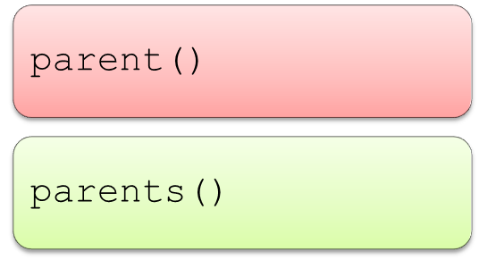
Ancestors
An element who is a parent, grandparent, great-grandparent, and so on of another element is known as the ancestor of that element.
You need to traverse up the DOM to find the ancestor of an element.
The commonly used methods to traverse up the DOM are:
The parent() method:
  Returns the direct parent element of the selected element.
  Traverses only a single level up the DOM tree.

Slide 8
Ancestors (Contd.)
For example, consider a website, VISIT AUSTRALIA.COM, that displays the different tourist destinations, as shown in the following code snippet:
<TABLE width="100%" border="1" cellspacing="0" cellpadding="5" class="table2">
<TR class="BlueM">
<TD width="20%"><IMG src="img/BlueMoun.jpg" alt="BlueMountain" width="100%"></TD>
<TD width="80%" valign="top"><DL><DT><STRONG>Blue Mountains</STRONG></DT><DD>Blue Mountains National Park is one of the most well-known parks in Australia. The views from the park's lookouts are magnificent. You will look over waterfalls, interesting rock formations, and hazy blue forests. <BR><A href="Destination1.html">Read more</A></DD></DL></TD>
</TR>
<TR class="PortJ">
<TD width="20%"><IMG src="img/Portjack.jpg" alt="Port_jackson" width="100%"></TD>
<TD width="80%" valign="top"><DL><DT><STRONG>Port Jackson</STRONG></DT><DD>Port Jackson is the natural harbour of Sydney. It is an inlet of the Tasman Sea, which is a part of the South Pacific Ocean.

Slide 9
Ancestors (Contd.)
<BR><A href="Destination3.html">Read more</A></DD></DL></TD>
</TR>
<TR class="OperaH">
<TD width="20%"><IMG src="img/SydneyHouse.jpg" alt="Opera House" width="100%"></TD>
<TD width="80%" valign="top"><DL><DT><STRONG>Sydney Opera House</STRONG></DT><DD>The Sydney Opera House is a multivenue performing arts centre in Sydney.<BR><A href="Destination4.html">Read more</A></DD></DL></TD>
</TR>
<TR class="Harb">
<TD width="20%"><IMG src="img/SydneyHarbour.jpg" alt="Harbour Bridge" width="100%"></TD>
<TD width="80%" valign="top"><DL><DT><STRONG>Sydney Harbour Bridge</STRONG></DT><DD>The Sydney Harbour Bridge is a steel through arch bridge across Sydney Harbour. The dramatic view of the bridge, the harbour, and the nearby Sydney Opera House is an iconic image of Sydney, and Australia. <BR><A href="Destination5.html">Read more</A></DD></DL></TD>
</TR></table>

Slide 10
Ancestors (Contd.)
To find out the parent of <TR> element and make its content bold, you can use the following code snippet:
In the preceding code snippet, to retrieve the parent element of the <TR> element whose class attribute is PortJ, the parent()method is used.
The content of the selected element is made bold using the font-weight property.
<script>
$(document).ready(function(){
$(".PortJ").parent().css({"font-weight": "bold"});});
</script>

Slide 11
Ancestors (Contd.)
The parents() method:
  Is used to retrieve all ancestor elements of the selected element, up to the root element of the document.
For example, to change the background color of the Destination.html page, you can write the following code snippet:
The preceding code snippet selects the ancestors of the <tr> element whose class attribute is PortJ, using the parents() method and changes their background color to cornsilk.
<script>
$(document).ready(function(){
$(".PortJ").parents().css({"background-color": "#FFF8DC"});
});
</script>

Slide 12
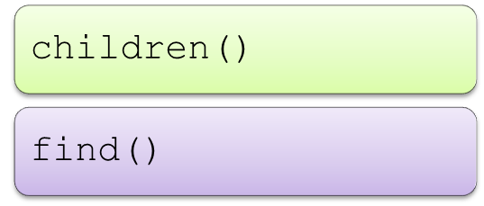
Descendants
An element who is a child, grandchild, great-grandchild, and so on of another element is known as the descendant of that element.
You need to traverse down the DOM tree to find the descendant of an element.
The methods used to traverse down the DOM are:
The children() method:
  Is used to retrieve all direct children of the selected element.
  Traverses a single level down the DOM tree.
The following code snippet shows the use of the children() method:
$(".Class1").children().css({"font-style": "italic"});

Slide 13
Descendants (Contd.)
The find() method:
  Is used to retrieve the descendant elements of the selected element.
  Searches up to the last element of the DOM tree.
The following code snippet shows the use of the find() method:
<script>
$(document).ready(function(){
$("ul").find("li").css({"font-weight":"bold"});});
</script>

Slide 14
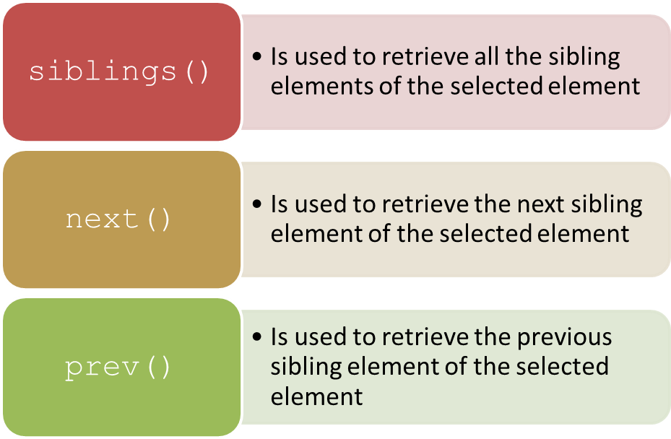
Siblings
Siblings refer to the elements that have the same parent.
You can find siblings of an element by traversing sideways in the DOM tree.
The methods for traversing the siblings of an element are:

Slide 15
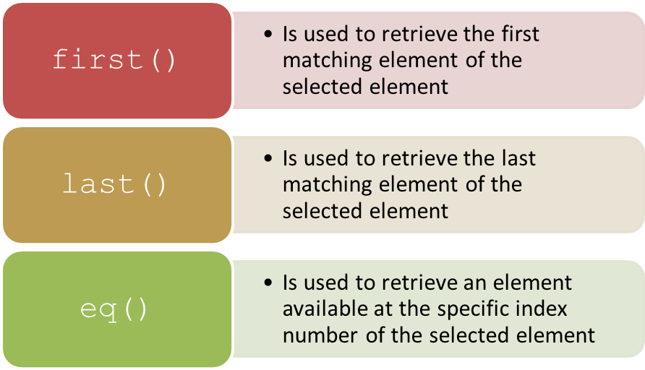
Filtering
jQuery provides various methods through which you can perform filtering operations on DOM.
These methods are:
filter()
  Is used to specify a condition to select elements

Slide 16
Just a Minute
Which one of the following methods retrieves all ancestor elements of the selected element, up to the root element of the document?
  parent()
  parents()
  child()

Slide 17
Just a Minute (Contd.)
Answer:
  parents()

Slide 18
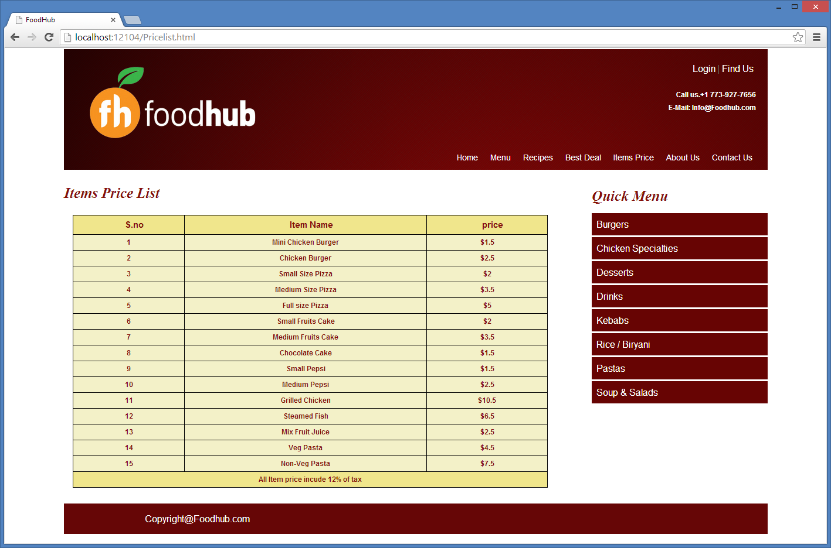
Activity: Traversing Nodes Using jQuery
The management of FoodHub has asked you to create a Web page that displays the menu item list along with the price of each item. This page should be based on the following guidelines:
  The background color of the first and last nodes should be the same.
  All other nodes’ colors should be the same except for the first and last nodes.
The Web page should appear, as shown in the following figure.

Slide 19
Activity: Traversing Nodes Using jQuery (Contd.)
Prerequisite: To perform this activity, you need to use the Foodhub.zip file.

Slide 20
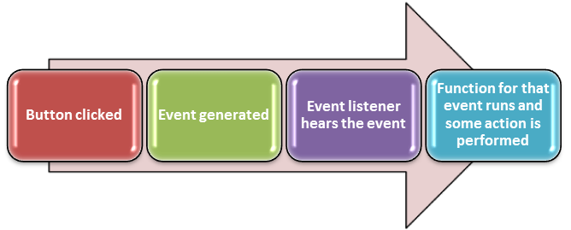
Implementing jQuery Events
A user’s action, such as a mouse click or a key press, on which a Web page can respond, is known as an event.
An event is a mechanism that allows a piece of code to run when something happens.
In jQuery, events are handled by using event listeners or predefined event methods.
An event method is used to detect an event and trigger a function when that event occurs.
The following figure displays the sequence from the generation of event to the action performed.

Slide 21
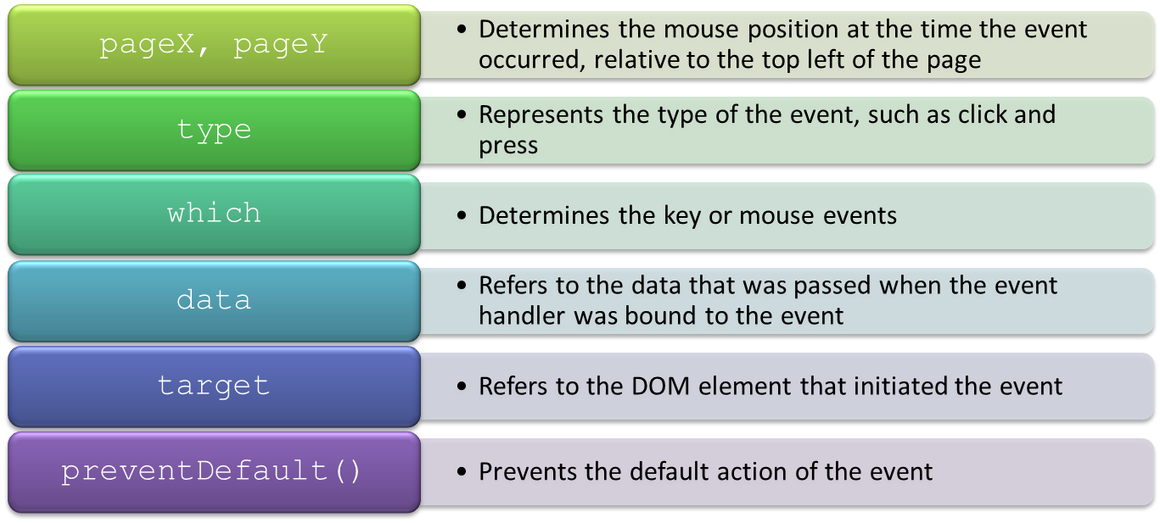
jQuery Event Object
An event object is the source upon which the event occurs.
It is used to determine the nature of the event, and to control the event’s default execution behavior.
It contains many properties and methods including:

Slide 22
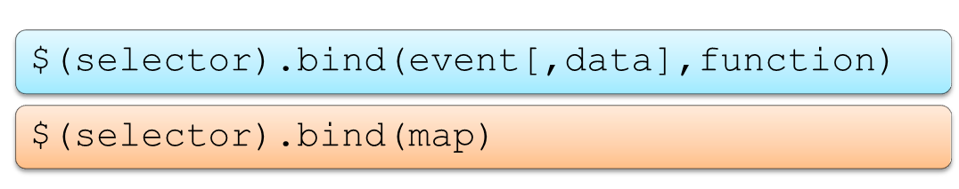
jQuery Event Object (Contd.)
To attach event handler functions to multiple events of the selected elements, jQuery provides some methods, such as:
  bind()
  on()
The bind() method:
  Is used to attach one or more event handlers for the selected elements.
  Can be invoked in the following forms:

Slide 23
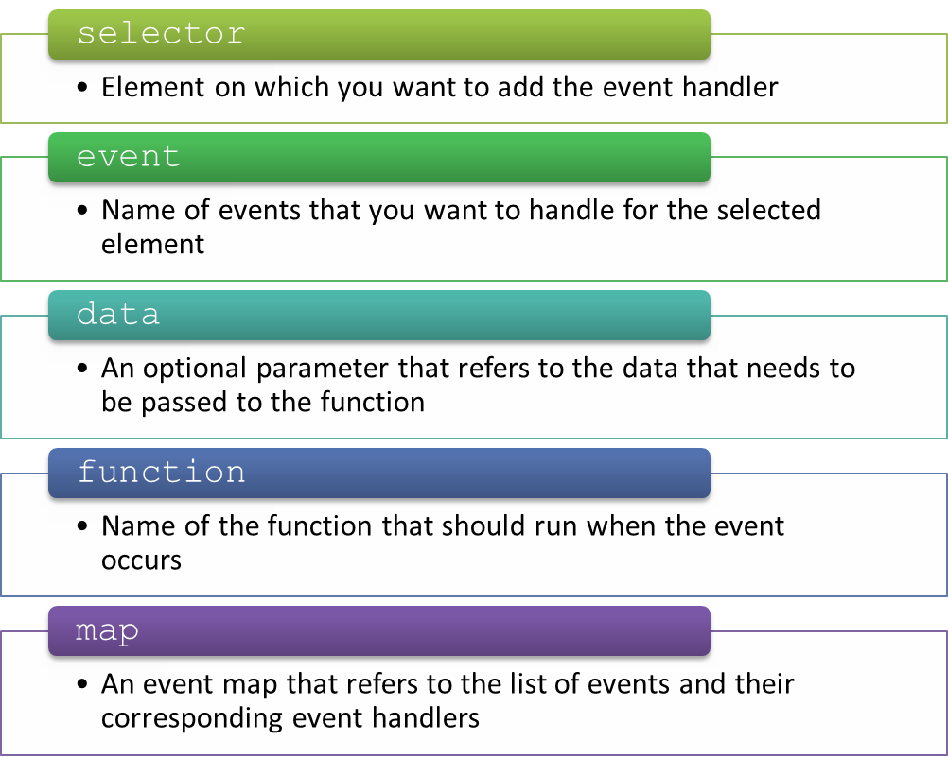
jQuery Event Object (Contd.)
In the preceding syntax:

Slide 24
jQuery Event Object (Contd.)
As shown in the following code snippets, the bind()method is used to perform the different tasks:
  To attach an event handler to a single event:
  To attach an event handler to multiple events:
$("p").bind("click",function(){
alert(" Click event occurred"); });
$("#btn").bind("mouseover mouseout",function(){ $("#btn").toggleClass("intro"); });

Slide 25
jQuery Event Object (Contd.)
  To pass data to an event handler:
  To specify an event map for a specific element:
$(document).ready(function(){
$("button").bind("click", {message: "You just clicked me!"}, handler)});
$(document).ready(function(){
$("button").bind({
click:function(){$("p").slideToggle();},
mouseover:function(){$("body").css
("background-color","#E9E9E4");$("button").css( "color",
"red");},
mouseout:function(){$("body").css
("background-color","#FFFFFF");$("button").css("color", "black");} }); });

Slide 26
jQuery Event Object (Contd.)
The on() method enables you to attach one or more event handlers for the selected elements and child elements.
The syntax to use the on() method is:
$(selector).on(event[,childSelector][,data],function [,map])
For example, in the following code snippet, the on() method is used to attach the click event to the <p> element, which is added on the click event of a button:
Whenever the user clicks this <p> element, the event handler attached to this click event gets executed, which will hide the <p> element.
$("div").on("click","p",function(){
$(this).hide();
});

Slide 27
Just a Minute
Which one of the following properties of the event object determines the key or mouse events; the button or the key that was pressed?
  type
  data
  which

Slide 28
Just a Minute (Contd.)
Answer:
  which

Slide 29
Activity: Implementing jQuery Events on HTML Elements
Your team leader has assigned you a task to create a responsive Contact Us form in the FoodHub website. In addition, you need to perform the client-side validation on the form using jQuery events. The Contact Us form should appear when a user clicks the Contact Us link on the home page. The Contact Us form should be based on the following guidelines:
  The background and text color of the fields should change whenever input fields gain or lose focus.
  The casing of text entered in input fields should change to uppercase automatically.
  The input fields should not be left empty.
  The first and last name fields should contain only letters.
  The contact number should have only numbers.
  The email id of a user should be valid.
  The input message should have at least 30 characters.

Slide 30

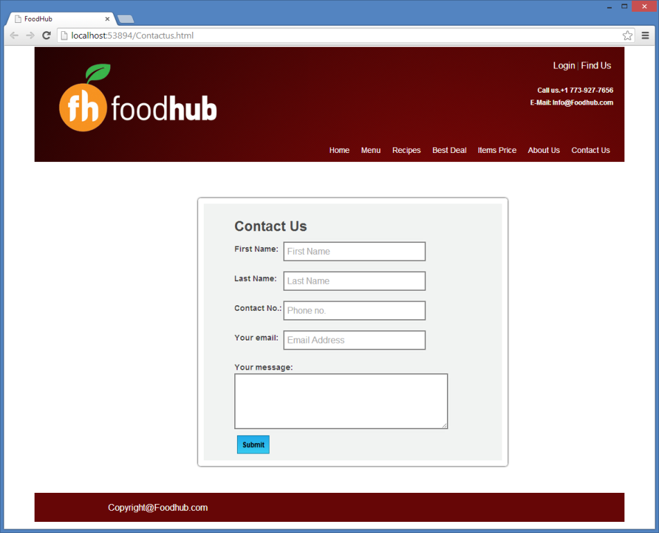
Activity: Implementing jQuery Events on HTML Elements (Contd.)
The Contact Us form should appear, as shown in the following figures.
Prerequisite: To perform this activity, you need to use the Foodhub.zip file.

Slide 31
Summary
In this session, you learned that:
  DOM represents the logical structure of HTML documents.
  DOM describes the ways through which a document is accessed and manipulated.
  jQuery provides a lot of methods that enable you to traverse DOM. These methods are divided into the following categories:
    Ancestors
    Descendants
    Siblings
    Filtering
  A user’s action, such as a mouse click or a key press, on which a Web page can respond, is known as an event.
  An event object is the source upon which the event occurs.
  An event object is used to determine the nature of the event, and to control the event’s default execution behavior.
  To attach event handler functions to multiple events of the selected elements, jQuery provides some methods, such as:
    bind()
    on()

Slide 32
What’s Next?
After this session, you need to do the following tasks:
  Go through the recorded lectures on the following topics through Cloudscape:
    Traversing the DOM
    Implementing jQuery Events
  Perform the following exercises of Chapter 6:
    Exercise 2
    Exercise 3
  Attend Cycle Test 5

